Slide 1
Profiling and Optimization on a Rodinia program K-nearest Neighbors
PG1
Guoqing Liang, Martin Börjeson, Tianze Yao, Yitong Li

Slide 2
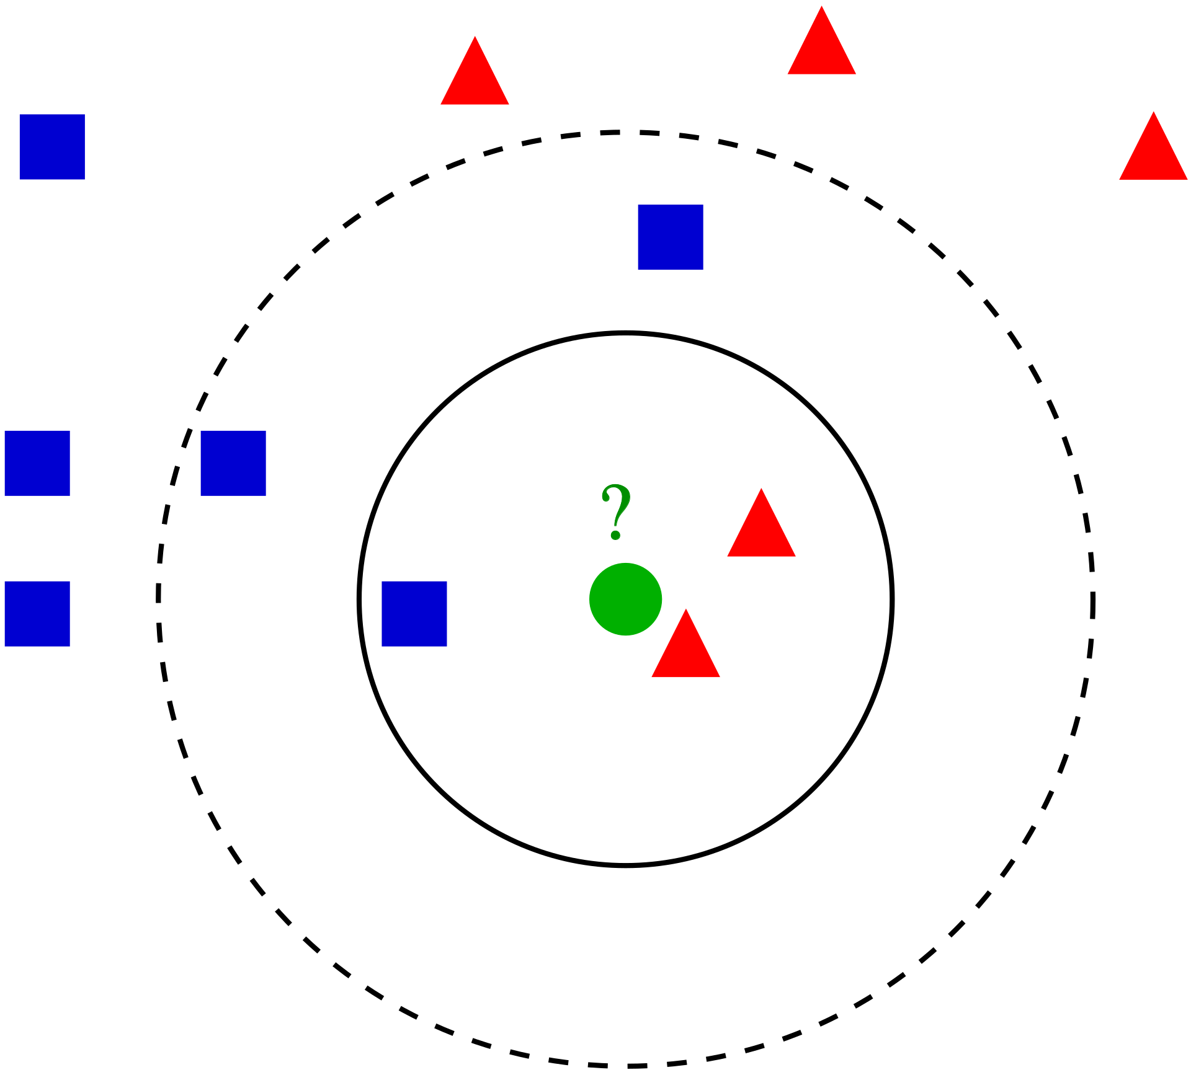
Introduction - KNN
K-nearest Neighbors(KNN) is used for classification and regression in statistics.
The input consists of the k closest training examples in a data set.
KNN Classification: plurality vote
KNN regression : property value

Slide 3
Methodology
Basic knowledge of KNN
Determine the experimental Setup
Analyze KNN in Rodinia
Optimization methods
-Algorithm Select
-GPU Arrangements
Results & Discussion
Conclusion

Slide 4
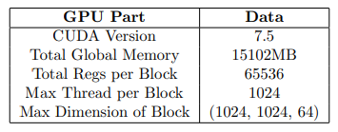
Experimental Setup
Experiment Platform:
Google Drive ,Google Colab
GPU: NVIDIA Tesla T4
Coding tools: Visual Studio Code
Test tools: NVIDIA Visual Profiler

Slide 5
Introduction - KNN in Rodinia
Providing the input of KNN, which find k closest training examples.
Training examples include (latitude, longitude) to calculate the euclidean distance.

Slide 6
Analyze of KNN in Rodinia
Obvious, most of time is costed in the final step: find k closest. And the proportion will further increase as k increases.
According to the code, it copy all distances to host and then use a ineffective algorithm, with the time complexity of O(n^2) on average.
Here is the performance bottlenecks.

Slide 7
Optimization methods
Move the step “Find k closest examples” to GPU, and only copy the results to host
Use more effective algorithm to the step “Find k closest examples”
Use asynchronous copy and streams optimization GPU Arrangements

Slide 8
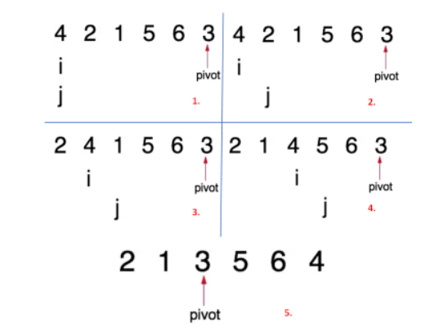


Algorithm Select
Quickselect
On average, O(n) time complexity.
Distribute examples into m parts, then calculate another time to get the final answer.

Slide 9
Algorithm Select
Min-heap
Time complexity of O(nlogk)
Use same way to distribute examples(use Fibonacci heap), get
Sort algorithm
Time complexity of O(nlogn)
Cannot compute parallelly

Slide 10
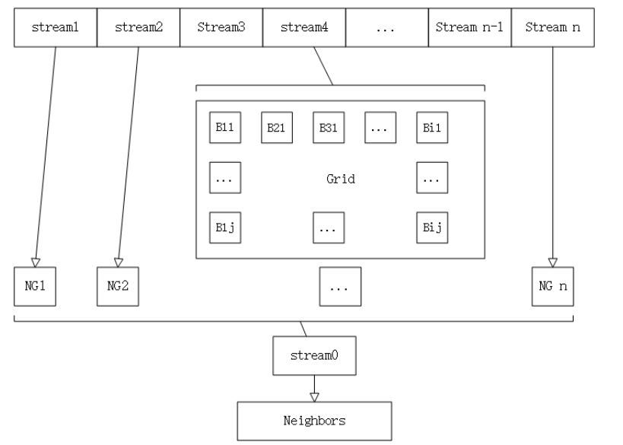
GPU Arrangements
Optimizing Host-Device Data Communication by several streams and asynchronous copy

Slide 11
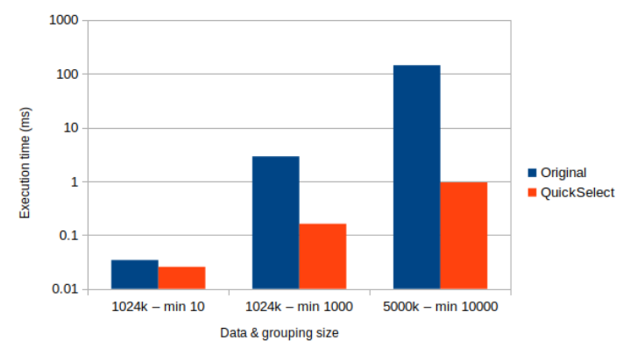
Results & Discussion
After implementing the QuickSelect and running it in parallel on the GPU, the program ran up to 150 times faster for large database and k. The performance uplift is much smaller, in the range of 33% faster.

Slide 12
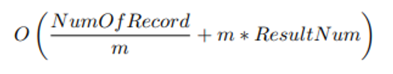
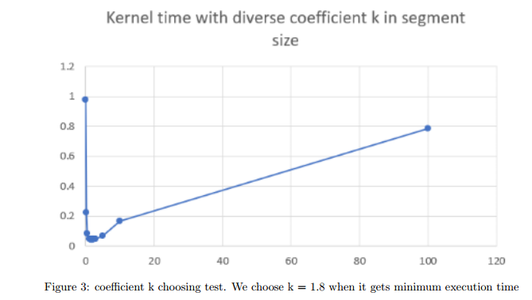

Results & Discussion
In QuickSelect, we use m threads to parallel computing. Ignoring the arithmetic constants, it can be easily obtained when , the algorithm is the most effective.
We test the most efficient value of m’, which m’ = k*m.

Slide 13
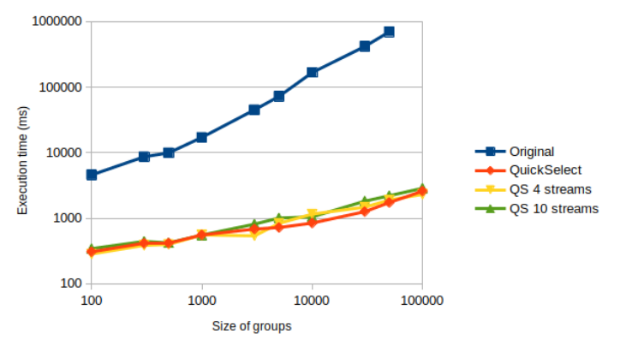
Results & Discussion
We observe a roughly linear growth in execution time as k increases in the original code. However, the growth in execution time in our implementation is sublinear.
Varying the thread per block didn’t have a big effect on execution time for larger data sizes, but we observed small performance gains by going to 1024 threads per block.

Slide 14
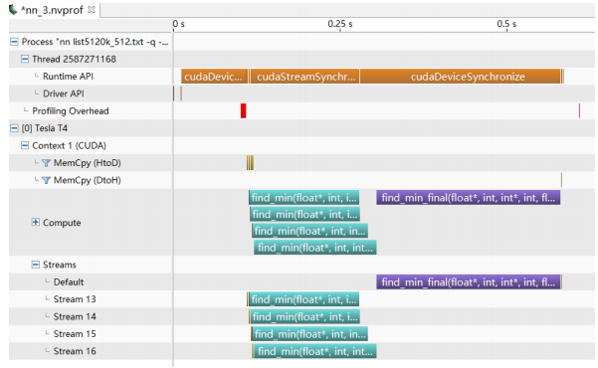
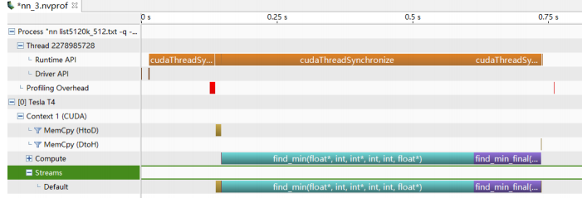
Results & Discussion
The streams optimization didn’t yield as drastic of an improvement, but we still observed a performance uplift in the largest data sets.
4 streams seems to be close to the optimum.
Reason: The kernel execution time is much larger than the device to host memcopy time.

Slide 15
Conclusion
Our implementation of k-NN was generally much faster than the original implementation and utilizes the GPU to a much greater extent than it did originally.
Much of this improvement comes from the improved selection algorithm, QuickSelect.
Further optimizations came from running multiple streams, with 4 appearing to be optimal, and tuning the number of threads per block to 1024.

Slide 16
Findings and takeaways
Never use recursion and arrays defined with variables in the kernel
-I use new to avoid compile error but invalid in large data.(use registers)
-Recursion costs stacks, will also lead to error in large data
Testing and feedback
Teamwork
-We clarified everyone's responsibilities and completed the project efficiently
-Frequent communication allows us to discover and solve each other's problems

Slide 17
Thank you!
PG1
Guoqing Liang, Martin Börjeson, Tianze Yao, Yitong Li

